Slide 1
®
Introduction to Metal Roofing and Siding
March 2023
Marketing & Engineering Department

Slide 2
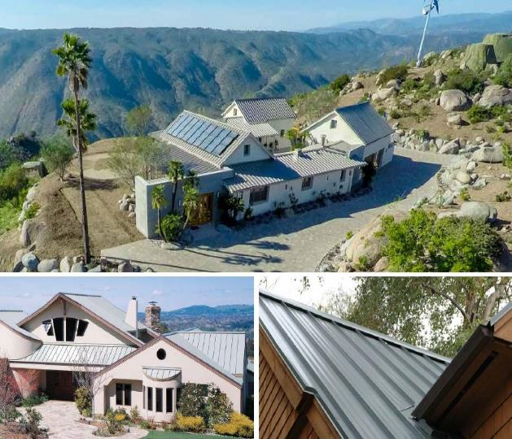
ASC BUILDING PRODUCTS
Distinctive Design. Long Lasting Performance.
ASC Building Products is a leading manufacturer of premium metal roofing and metal siding products designed to provide long-lasting protection.
As a trusted brand for over 50 years, you can count on ASC Building Products’ variety of metal panels and colors to provide performance, long-lasting value, and peace of mind to protect what’s important
Giving homeowners and building owners the confidence to enhance, protect and extend the beauty of their homes or buildings with metal is our mission and promise.

Slide 3
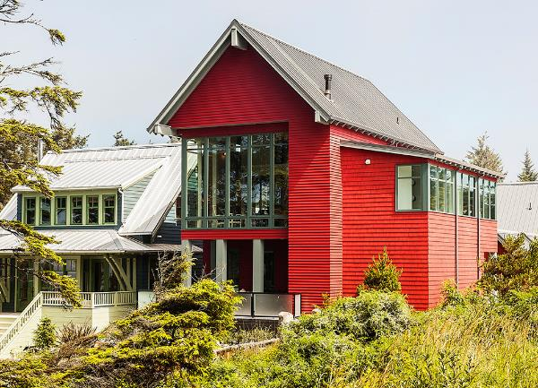
Metal Roofing basics
1
Benefits of Metal Roofing
2
Metal Panels Offered
3
Trims, Flashings, and Accessories
4
Colors and Warranties
5
Estimating Services and E-Commerce
6
Packaging, Shipping, Delivery & Storage
7
Installation Resources
8
Online Resources

Slide 4
1. BENEFITS OF METAL ROOFING

Slide 5
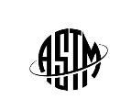
Benefits of metal roofing¹
LONG LASTING. Lasts up to 60 years with proper maintenance and installation.
ENERGY EFFICIENT. Save as much as 25% in energy costs with “cool” colors.
SAFE. Metal roofs will not ignite or support combustion during a wildfire or lightning strike.
ENVIRONMENTALLY FRIENDLY. 100% recyclable at the end of its life cycle.
LOWER INSURANCE COSTS. Qualifying impact-resistance certifications may qualify for premium discounts.
DURABLE. Metal roofs withstand extreme weather conditions and have the highest Class 4 hail impact resistance.²
¹ MRA – Metal Roofing Alliance ² in accordance to UL 2218.

Slide 6
2. METAL PANELS OFFERED

Slide 7
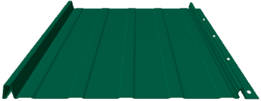
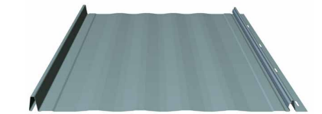
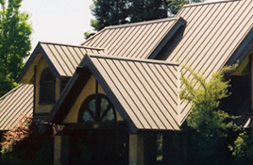
SKYLINE ROOFING® and Skyline Roofing® hp
Standard Ribbed
Striated
Classic standing seam metal roof panel with concealed fastener design. The perfect choice for new residential construction or remodels.
Available in 12” or 16” coverages in 26ga colors.
Skyline Roofing hp is a 24ga high-performance panel available only in a 16” coverage and 24ga premium colors.
Click here to see more Skyline Roofing details
Click here to see more Skyline Roofing hp details

Slide 8
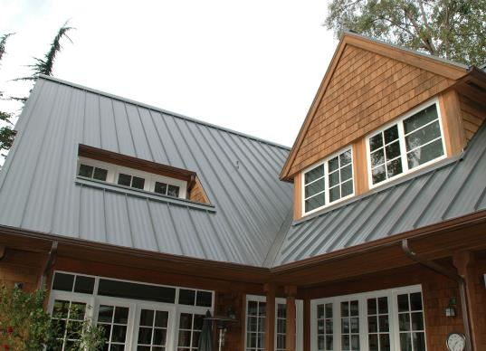
Design Span® hp
Performance-rated, premium standing seam metal roof panel ideal for residential and commercial applications.
12”, 16”, 17” & 18” coverages in 24 & 22 ga colors.
Subtle striations available for 16”, 17” & 18” sizes.
Snap-together design – no field seaming required.
Subtle striations between ribs help reduce the appearance of oil-canning as shown above.
Click here to see more Design Span hp details

Slide 9
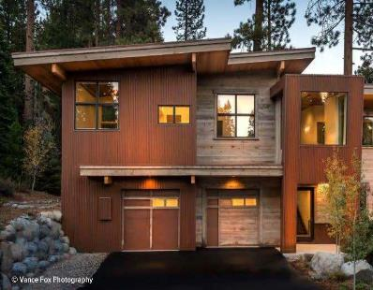
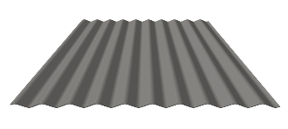
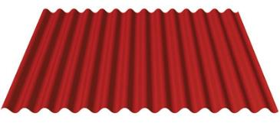
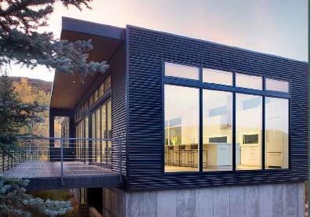
Corrugated metal roofing & siding
2 ½” Corrugated
Nu-Wave Corrugated®
Exposed fastener panel with 1/2” deep corrugations offered in 29 & 26ga colors.
This panel is a top choice for projects ranging from country to modern design.
Exposed fastener panel with 7/8” deep corrugations offered in 26, 24, & 22ga colors.
This classic corrugated panel is suited for a variety of roofing and siding applications.
Click here to see more 2 ½” Corrugated details
Click here to see more Nu-Wave Corrugated details

Slide 10
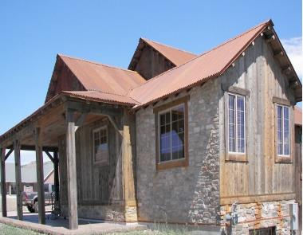
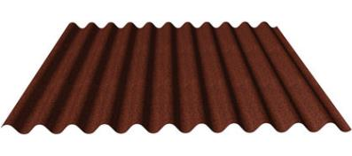
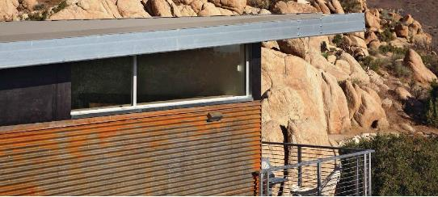
Ironox corrugated
22 ga unpainted and untreated
steel allows the surface to rust
and form a natural iron oxide finish.
IronOx Corrugated is ideal for creative builders looking to design with the aesthetic beauty of rusted corrugated steel.
Note: IronOx does not meet the minimum requirements for a metal roof covering per the IBC® and IRC®. Check the building code requirements for your project before ordering or installing.
Click here to see more IronOx Corrugated details

Slide 11
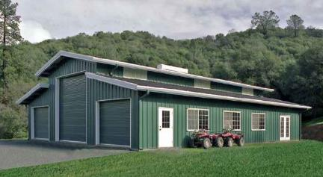
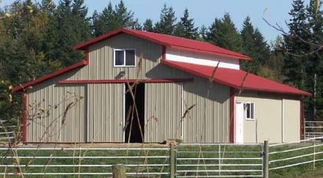
PBR Panel
Ideal for pre-engineered metal, post-frame, and agricultural buildings.
PBR Panel offers a unique, yet flexible design when combined with other building materials and is perfect for use in buildings for livestock and animal confinement.
Available in 26, 24 & 22ga colors and paint systems.
Click here to see more PBR Panel details

Slide 12
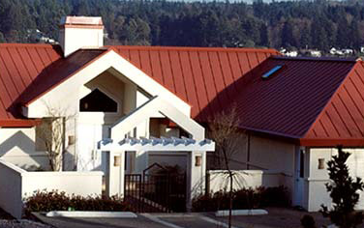
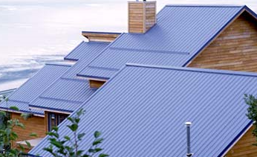
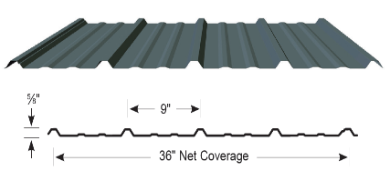
Strata Rib® & Nor-Clad®
Strata Rib®
Strata Rib features a ¾” reinforced major rib which provides added strength and durability.
Both are 36” exposed fastener panels available in 29 and 26ga colors.
Nor-Clad®
Nor-Clad is an industry-standard panel that can help save time and money with its ease of installation.
Click here to see more Strata Rib details
Click here to see more Nor-Clad details

Slide 13
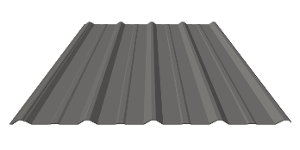
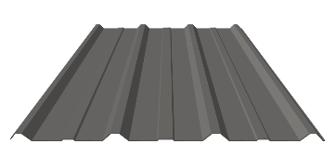
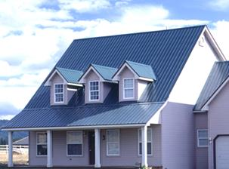
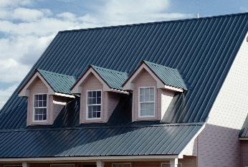
DELTA RIB™ & DELTA RIB™ III
Delta Rib™
Delta Rib™ III
Delta Rib and Delta Rib III are exposed fastener panels ideal for residential and light-commercial roofing or siding projects.
Both are available in a variety of 29 and 26ga colors.
Available in a 24” (Delta Rib) or 36” (Delta Rib III) coverages.
Click here to see more Delta Rib details
Click here to see more Delta Rib III details

Slide 14
3. TRIMS, FLASHINGS &
ACCESSORIES

Slide 15
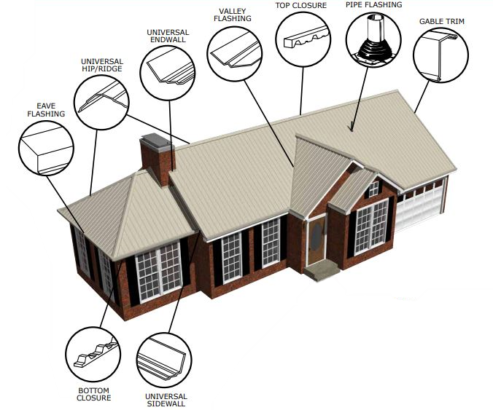
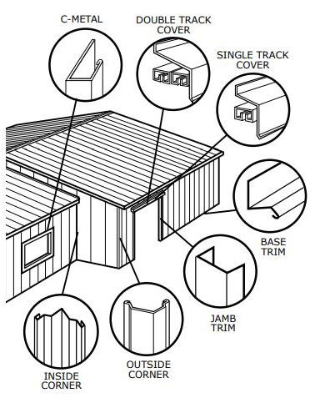
TRIMS & FLASHINGS
Click here to see our most popular Trims available

Slide 16
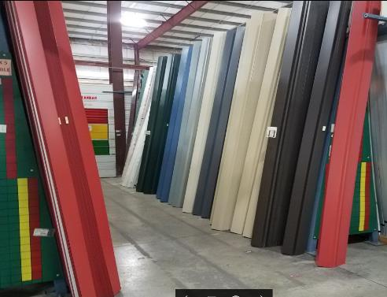
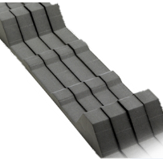
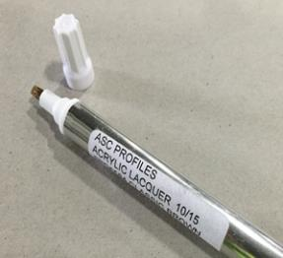
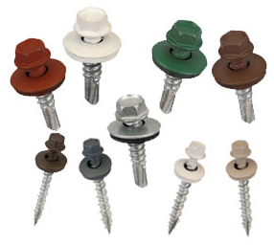
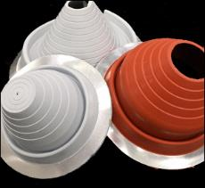
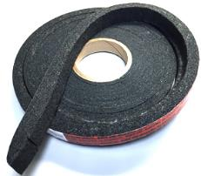
flashings & accessories
Wide variety of hardware and accessories.
Painted screws and rivets
Mastic tape
Foam closures for each panel profile type
Touch-up paint pens
Standard and high-temperature boots for pipe penetrations
Click here to learn more about Foam Closures

Slide 17
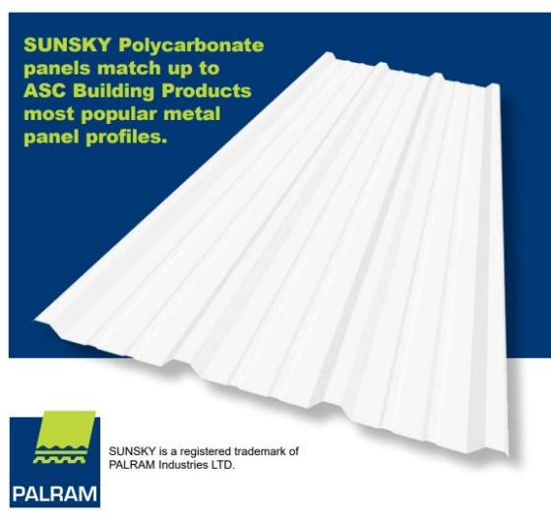
Polycarbonate – Skylight & sidelight panels
Polycarbonate panels are virtually unbreakable, offering up to 20 times greater impact resistance compared to fiberglass.
Available in the following popular panel profiles:
Panel | Length | Color
PBR Panel | 12’ | White Opal
Nu-Wave® Corrugated | 12’ | White Opal
2 ½” Corrugated | 8’ • 10’ • 12’ | White Opal
Nor-Clad® | 2’ • 8’ • 10’ • 12’ | Clear & White Opal
Strata Rib® | 2’ • 8’ • 10’ • 12’ | Clear & White Opal
Delta Rib™ | 8’ • 10’ • 12’ | Clear & White Opal
Delta Rib™ III | 8’ • 10’ • 12’ | Clear & White Opal
Click here for additional SunSky Polycarbonate documents

Slide 18
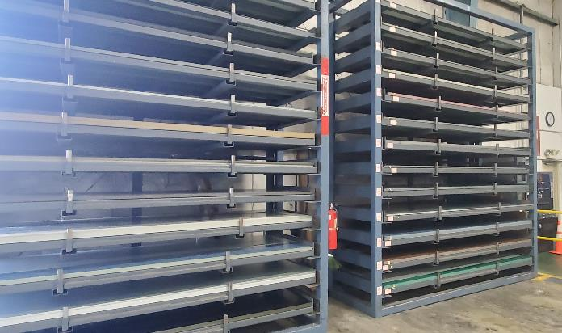
FLAT SHEET
ASC Building Products offers Flat Sheet service available in all Standard Colors and paint systems.¹
40-7/8” x 10’-6” in 29 ga Dura Tech™ xl Colors
41 9/16” x 10’-6” in 26 ga Dura Tech™ xl Colors
42 3/4” x 10’ in 26 ga Dura Tech™ nt Colors
48 3/8” x 10’ in 24 ga Dura Tech™ 5000/mx Colors
¹Inquire with Sales Representative for lead times and availability.
All painted Flat Sheet comes with strippable film applied to help keep the sheets protected.

Slide 19
4. COLORS AND WARRANTIES

Slide 20
Good, Better, & Best paint for metal roofing & siding
Paint System | Standard Polyester (POLY) | Silicon Modified Polyester (SMP) | Polyvinylidene Fluoride (PVDF)
ASC Building Products paint system name | ColorGuard 25 with Spectrascape® | Dura Tech™ xl Dura Tech™ nt | Dura Tech™ 5000 Dura Tech™ mx
Overall | GOOD | BETTER | BEST
Gauge | 29 | 29 and 26 | 24 and 22
Price Point | Lowest | Moderate | Higher
Warranty | 25 Year Limited | Limited Lifetime Residential 25 Year Non-Residential | Limited Lifetime Residential
Durability | Limited to Good | Medium to High | Highest
Application | Versatile. Agricultural or Industrial buildings. | Wide Range. Residential and Light Commercial. | High-end. Residential, Architectural, and Commercial.
Click here to learn more about paint systems used for Metal Roofing & Siding

Slide 21
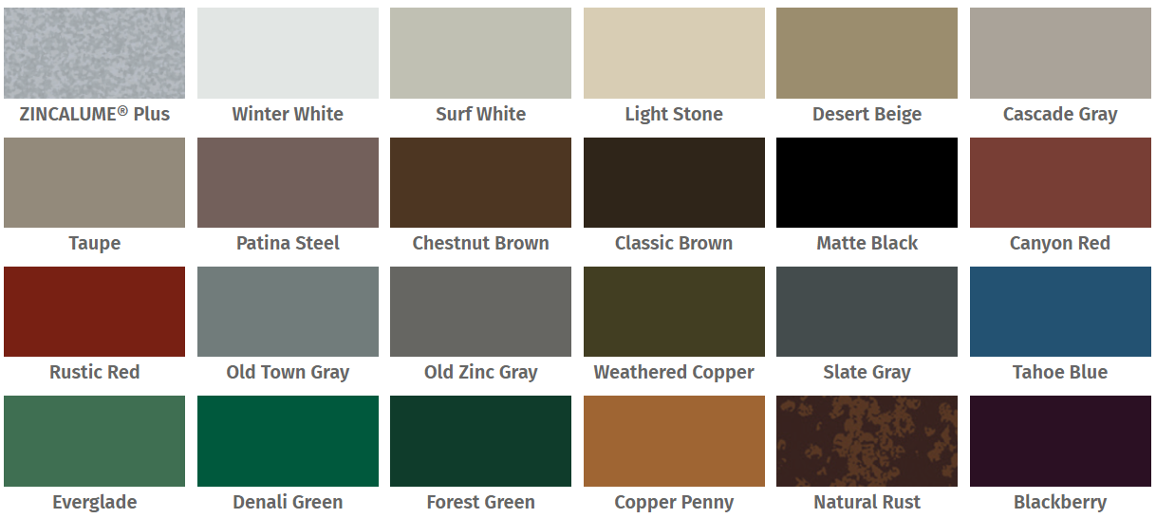
Standard 29 and 26 gauge colors
Dura Tech™ xl Paint System (SMP)
Click here to see our Interactive Color Chart for a full list of panel profiles and colors offered

Slide 22
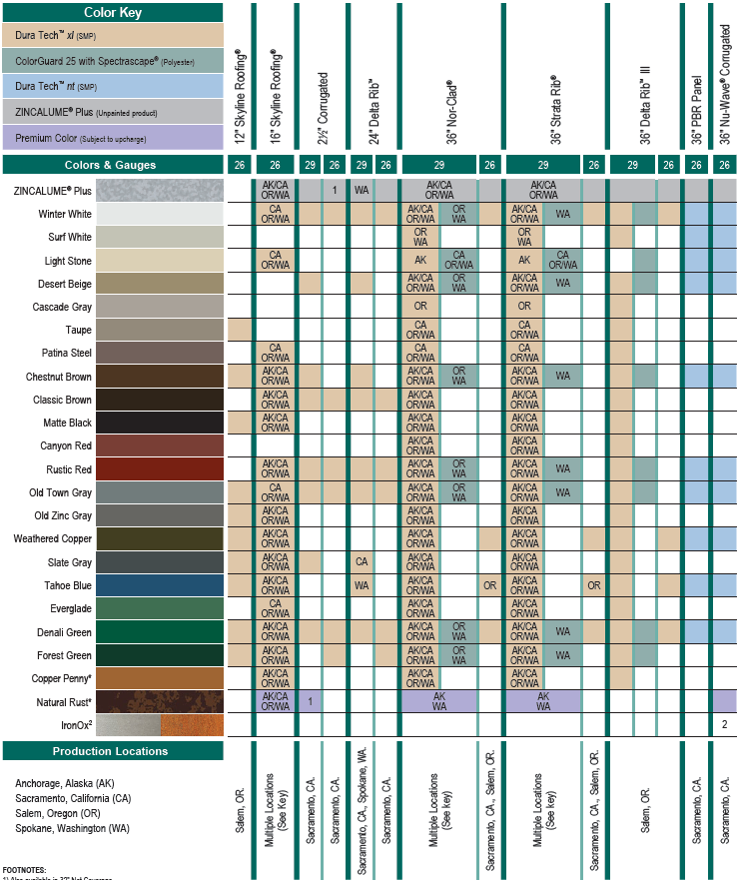
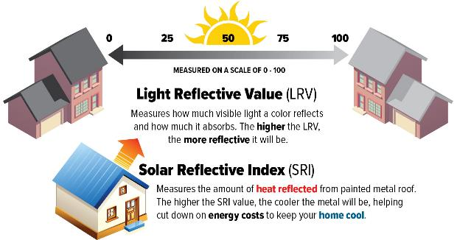
Standard 29 and 26 gauge color MATRIX
Not every panel is available in every color.
Refer to the Color Chart Matrix or Interactive Color Chart on the website.
All colors are listed with the Cool Roof Rating Council (CRRC), and the solar performance data aids in meeting sustainability targets.
Click here to see the downloadable PDF Color Chart Matrix

Slide 23
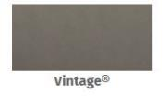
Standard 24 and 22 gauge colors
Dura Tech™ 5000/mx Paint System (PVDF)
Click here to see our Interactive Color Chart for a full list of panel profiles and colors offered

Slide 24
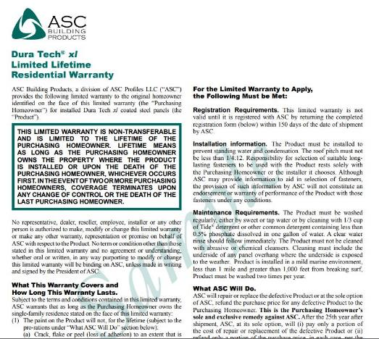
WARRANTIES
Sample Warranties Available Online
Limited Lifetime Residential and Non-Residential Warranties Are Available
Warranty | Paint System | Residential | Non-Residential
ZINCALUME® Plus | Bare | 25 Year | 25 Year
Dura Tech™ xl | SMP | Limited Lifetime | 25 Year
Dura Tech™ nt | SMP | N/A | 25 Year
Dura Tech™ xlp | SMP | Limited Lifetime | 25 Year
Dura Tech™ 5000/mx | PVDF | Limited Lifetime | N/A
Dura Tech™ 5000 print | PVDF | Limited Lifetime | N/A
ColorGuard 25 with Spectrascape® | POLY | 25 Year | 25 Year
Click here to see all Sample Warranties

Slide 25
5. ESTIMATING SERVICES & E-COMMERCE

Slide 26
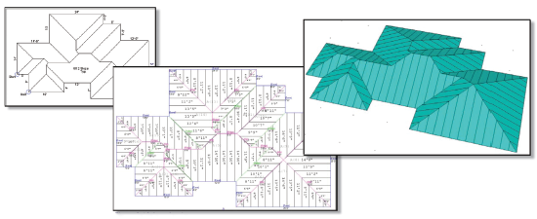
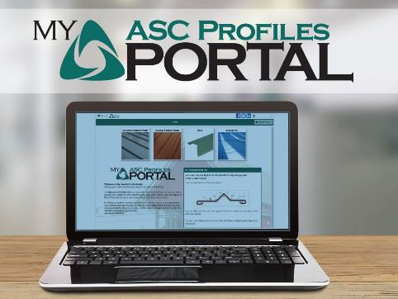
ESTIMATING SERVICES and E-COMMERCE
From customer roof specs to computer generated roof and wall estimates and 3D images.
Using state of the art professional software, we can provide quick, accurate, economical estimates and complete bills of materials.
The MyASCProfilesPortal is an easy and convenient ordering tool existing customers can use to get quotes, place their orders, check the status of their ​E-Commerce orders, and access historical E-Commerce orders
Click here to contact us about Estimating Services
Click here to access the MyASCProfilesPortal

Slide 27
6. PACKAGING, SHIPPING, DELIVERY, & STORAGE

Slide 28
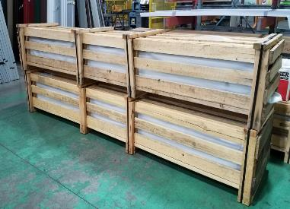
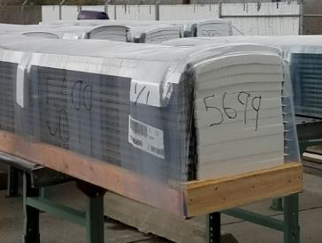
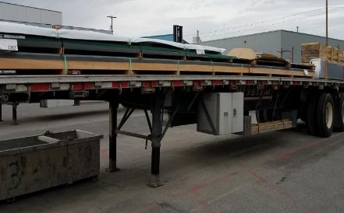
PACKING AND SHIPPING
Standard packaging is included in the price of most ASC Building Products. (long length, pro-pack, additional requested skids and export packaging is available for additional cost and is added to the standard packaging fees).
Freight is included in the price of most ASC Building Products to your yard. (Additional charges may apply for drop ships to the actual jobsite or full dedicated trucks within a reasonable distance from your yard).
Boom/Moffett trucks are also available in limited areas and can deliver directly to the jobsite. (boom trucks must be specified at time of order and may change lead times depending on availability. Additional charges may apply).
Customers must have proper off-loading equipment available to receive deliveries without boom trucks.

Slide 29
DELIVERY AND STORAGE
Pre-painted and pre-finished ZINCALUME® materials are subject to premature corrosion failures prior to installation if they are not handled and stored properly.
Excessive storage periods or poor storage conditions often result in water intrusion. Prolonged exposure to wet conditions can cause paint blistering and galvanized substrate corrosion or staining in as little as 2 weeks. This will invalidate the warranty.
Stored panels should be protected from exposure to moisture, direct sunlight, and precipitation. It is recommended to store panels indoors, for the utmost protection from environmental conditions. If outdoor storage is the only option, it is recommended to store panels elevated under a water-proof tarp and tilted to facilitate drainage.
Direct sunlight exposure can affect the protective film leading the adhesives to bond and potentially leave residue.
The best practice is to order materials when they are ready to be installed.
Click here to view all Technical Bulletins for Guidelines for Jobsite Storage

Slide 30
7. INSTALLATION RESOURCES

Slide 31
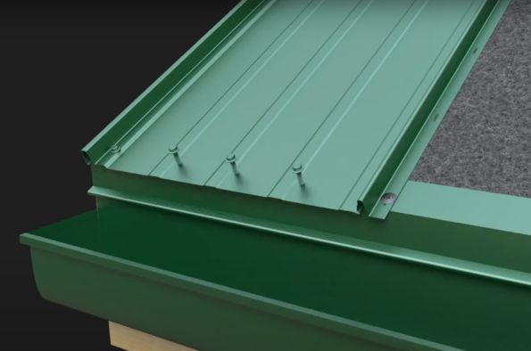
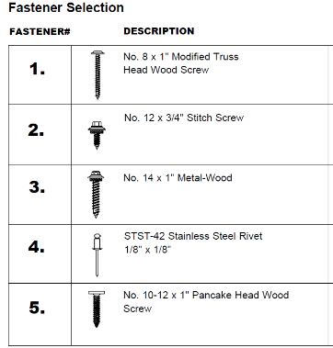
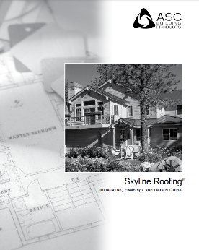
SKYLINE ROOFING® INSTALLATION
Minimum slope is 3:12 pitch. Minimum 30 lb. felt required.
Click here to view and download a PDF version of our Skyline Roofing Installation Guide
Click here to watch the Skyline Roofing Installation Video

Slide 32
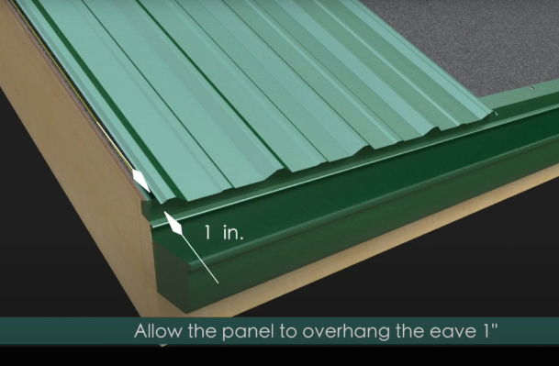
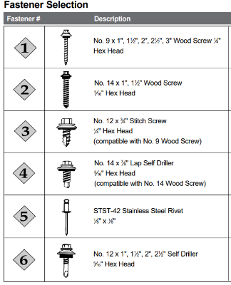
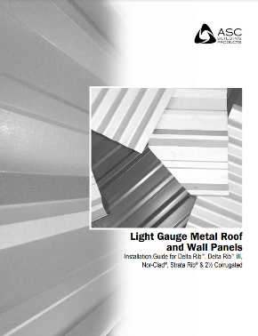
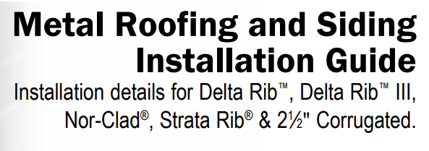
Exposed Fastener INSTALLATION
Minimum slope is 3:12 pitch. Minimum 30 lb. felt required.
Click here to view and download a PDF version of our Exposed Fastener Installation Guide
Click here to watch the Exposed Fastener Installation Video

Slide 33
8. ONLINE RESOURCES

Slide 34
PRODUCT VISUALIZER, COLOR FILTER & Product Samples
Visualize a variety of colors and metal panels while mix and matching with other building materials to achieve your desired look.
The Color Filter helps simplify your color decision by filtering colors based on a variety of categories backed by sales and industry data.
Request free product samples online and delivered to your door. Literature, Color Chips, and Panels samples are available.
Click here to visit the Product Visualizer
Click here to try the Color Filter
Click here to Request Free Product Samples

Slide 35
PRODUCT FINDER AND PROJECT GALLERY
The Product Finder helps identify the right metal roofing or siding panel for your needs. Narrow your search by gauge, application, performance and more.
View our Project Gallery to see our products and colors on completed projects. Get inspired with the versatile applications of our metal roofing and siding panels.
Click here to visit the Product Finder
Click here to visit the Project Gallery

Slide 36
RESOURCE Center
Resources are just a click away.
. We make it easier and convenient for you to obtain the information you need for your project.
Click here to visit the Resource Center

Slide 37
SUMMARY
PROMISING A LIFETIME OF BEAUTY AND DURABILITY
As an industry leader whose accredited third-party testing exceeds industry standards, ASC Building Products offers unmatched assurance its premium metal panels will deliver on performance and offer long-lasting beauty.
START YOUR METAL ROOFING OR SIDING JOURNEY TODAY

